Slide 1

Adventure Time
Created by Jonathan Lewis, Jacob Schwartz, Ian Davies

Slide 2
Premise
Top down, multiplayer real time hack and slash*
Adventure Time setting
C# with MonoGame/XNA
  Main game is built in MonoGame, which handles the game loop, outputting graphics to the screen, and handling input
  XNA project to output art assets
*For certain definitions of ‘hack’ and ‘slash’

Slide 3
Gameplay
Up to 2 players can play (code allows for 4)
There are only two characters to choose from (BMO and NEPTR)
There is only one monster spawning on the path
  Code allows for more
Random Map Generated
  Dirt path from start to end
  Trees
    Collidable and killable

Slide 4
Patterns Used
State - Used for different game states (gameplay, menu)
Singleton - Used for various game managers
Strategy - Attacks, menus
Flyweight - Handling art assets
Factory - Building entities
Decorator - Stats modification (through items)
Builder - Map data generation

Slide 5
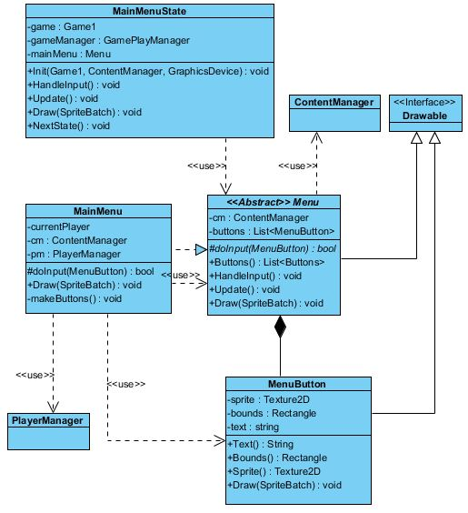
Game States

Slide 6
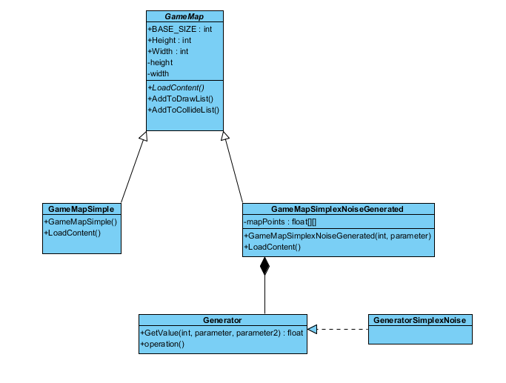
Map Loading

Slide 7
Entity Hierarchy

Slide 8
Demo

